Slide 1


Dr.M.Nirupama Bhat, Assoc. Professor, Dept of CSE

Slide 2

Learning Outcomes
To make the students
  understand few Encryption and Decryption methods
  evaluation the strength of those encryption and decryption methods
  learn cipher modes of operation
Dr.M.Nirupama Bhat, Assoc. Professor, Dept of CSE

Slide 3
Syllabus
Block Cipher Principles
Data Encryption Standard
Strength of DES
Differential and Linear Cryptanalysis
Block Cipher Design Principles
Advanced Encryption Standard
Evaluation Criteria of AES
AES Cipher
More on Symmetric Ciphers
Multiple encryption and Triple DES
Block Cipher Modes of Operation
RC4
Dr.M.Nirupama Bhat, Assoc. Professor, Dept of CSE

Slide 4

Dr.M.Nirupama Bhat, Assoc. Professor, Dept of CSE

Slide 5
Conventional Encryption Principles
An encryption scheme has five ingredients:
  Plaintext
  Encryption algorithm
  Secret Key
  Ciphertext
  Decryption algorithm
Security depends on the secrecy of the key, not the secrecy of the algorithm
Dr.M.Nirupama Bhat, Assoc. Professor, Dept of CSE

Slide 6
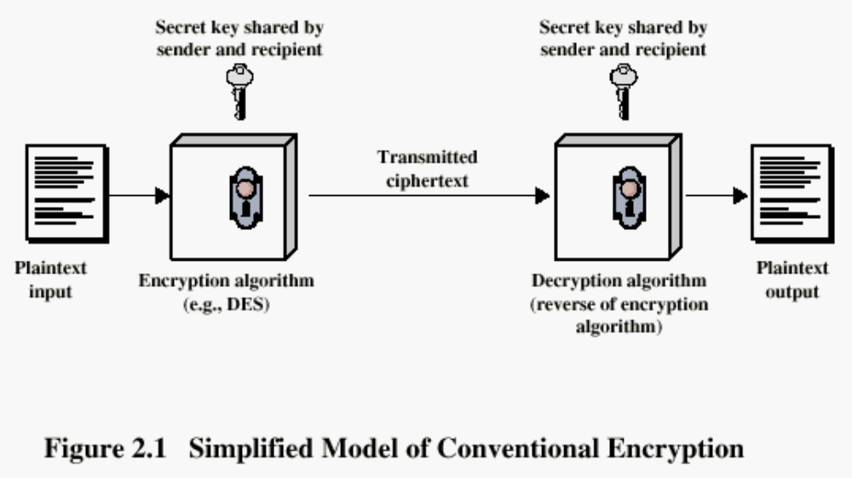
Conventional Encryption Principles
Dr.M.Nirupama Bhat, Assoc. Professor, Dept of CSE

Slide 7
Cryptography
Classified along three independent dimensions:
  The type of operations used for transforming plaintext to ciphertext
  The number of keys used
    symmetric (single key)
    asymmetric (two-keys, or public-key encryption)
  The way in which the plaintext is processed
Dr.M.Nirupama Bhat, Assoc. Professor, Dept of CSE

Slide 8
Modern Block Ciphers
will now look at modern block ciphers
one of the most widely used types of cryptographic algorithms
provide secrecy and/or authentication services
in particular will introduce DES (Data Encryption Standard)
Dr.M.Nirupama Bhat, Assoc. Professor, Dept of CSE
Notes:
Modern block ciphers are widely used to provide encryption of quantities of information, and/or a cryptographic checksum to ensure the contents have not been altered. We continue to use block ciphers because they are comparatively fast, and because we know a fair amount about how to design them.

Slide 9
Block vs Stream Ciphers
block ciphers process messages in into blocks, each of which is then en/decrypted
like a substitution on very big characters
  64-bits or more
stream ciphers process messages a bit or byte at a time when en/decrypting
many current ciphers are block ciphers
hence are focus of course
Dr.M.Nirupama Bhat, Assoc. Professor, Dept of CSE
Notes:
Block ciphers work a on block / word at a time, which is some number of bits. All of these bits have to be available before the block can be processed. Stream ciphers work on a bit or byte of the message at a time, hence process it as a “stream”.

Slide 10
Block Cipher Principles
most symmetric block ciphers are based on a Feistel Cipher Structure
needed since must be able to decrypt ciphertext to recover messages efficiently
block ciphers look like an extremely large substitution
would need table of 2⁶⁴ entries for a 64-bit block
instead create from smaller building blocks
using idea of a product cipher
Dr.M.Nirupama Bhat, Assoc. Professor, Dept of CSE
Notes:
An arbitrary reversible substitution cipher for a large block size is not practical, however, from an implementation and performance point of view. In general, for an n-bit general substitution block cipher, the size of the key is n x 2^{n}. For a 64-bit block, which is a desirable length to thwart statistical attacks, the key size is 64 x 2⁶⁴ = 2⁷⁰ = 10²¹ bits.

Slide 11
Claude Shannon and Substitution-Permutation Ciphers
In 1949 Claude Shannon introduced idea of substitution-permutation (S-P) networks
  modern substitution-transposition product cipher
These form the basis of modern block ciphers
S-P networks are based on the two primitive cryptographic operations we have seen before:
  substitution (S-box)
  permutation (P-box)
Provide confusion and diffusion of message
Dr.M.Nirupama Bhat, Assoc. Professor, Dept of CSE
Notes:
Claude Shannon’s 1949 paper has the key ideas that led to the development of modern block ciphers. Critically, it was the technique of layering groups of S-boxes separated by a larger P-box to form the S-P network, a complex form of a product cipher. He also introduced the ideas of confusion and diffusion, notionally provided by S-boxes and P-boxes (in conjunction with S-boxes).

Slide 12
Confusion and Diffusion
Cipher needs to completely obscure statistical properties of original message
A one-time pad does this
More practically Shannon suggested combining elements to obtain:
Diffusion – dissipates statistical structure of plaintext over bulk of ciphertext
Confusion – makes relationship between ciphertext and key as complex as possible
Dr.M.Nirupama Bhat, Assoc. Professor, Dept of CSE
Notes:
Every block cipher involves a transformation of a block of plaintext into a block of ciphertext, where the transformation depends on the key. The mechanism of diffusion seeks to make the statistical relationship between the plaintext and ciphertext as complex as possible in order to thwart attempts to deduce the key. confusion seeks to make the relationship between the statistics of the ciphertext and the value of the encryption key as complex as possible, again to thwart attempts to discover the key.
So successful are diffusion and confusion in capturing the essence of the desired attributes of a block cipher that they have become the cornerstone of modern block cipher design.

Slide 13
Feistel Cipher Structure
Horst Feistel devised the feistel cipher
  based on concept of invertible product cipher
Partitions input block into two halves
  process through multiple rounds which
  perform a substitution on left data half
  based on round function of right half & subkey
  then have permutation swapping halves
Implements Shannon’s substitution-permutation network concept
Dr.M.Nirupama Bhat, Assoc. Professor, Dept of CSE
Notes:
Horst Feistel, working at IBM Thomas J Watson Research Labs devised a suitable invertible cipher structure in early 70's.
One of Feistel's main contributions was the invention of a suitable structure which adapted Shannon's S-P network in an easily inverted structure. Essentially the same h/w or s/w is used for both encryption and decryption, with just a slight change in how the keys are used. One layer of S-boxes and the following P-box are used to form the round function.

Slide 14
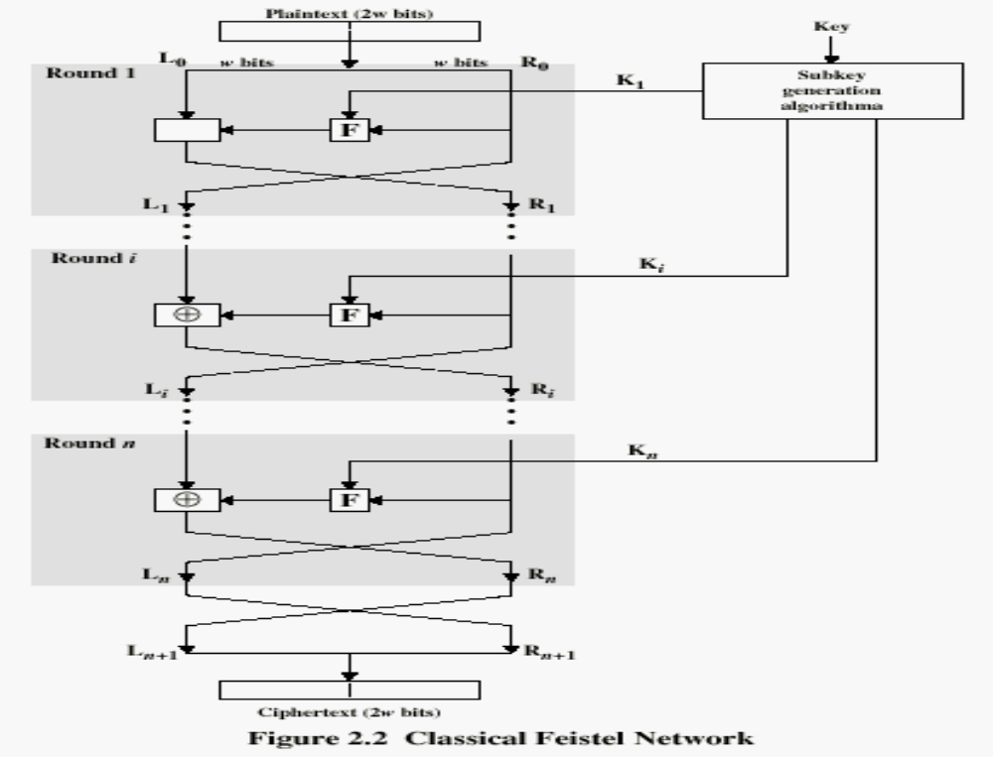
Dr.M.Nirupama Bhat, Assoc. Professor, Dept of CSE

Slide 15
Feistel Cipher Design Principles
Block size
  increasing size improves security, but slows cipher
Key size
  increasing size improves security, makes exhaustive key searching harder, but may slow cipher
Number of rounds
  increasing number improves security, but slows cipher
Subkey generation
  greater complexity can make analysis harder, but slows cipher
Round function
  greater complexity can make analysis harder, but slows cipher
Fast software en/decryption & ease of analysis
  are more recent concerns for practical use and testing
Dr.M.Nirupama Bhat, Assoc. Professor, Dept of CSE

Slide 16
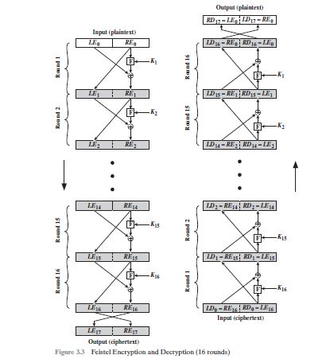
Dr.M.Nirupama Bhat, Assoc. Professor, Dept of CSE

Slide 17
consider encryption process,
LE16=RE15
RE16=LE15+F(RE15,K16)
On the decryption side,
LD1=RD0=LE16=RE15
RD1=LD0+F(RD0,K16)
=RE16+F(RE15,K16)
=[LE15+F(RE15,K16)]+F(RE15,K16)]
= LE15
Thus, we have
LD1=RE15
RD1=LE15,
So, we got that output of the 1st stage of decryption process is equal to 32-bit swap of the 15th round of the encryption process
Dr.M.Nirupama Bhat, Assoc. Professor, Dept of CSE

Slide 18


Dr.M.Nirupama Bhat, Assoc. Professor, Dept of CSE

Slide 19
Data Encryption Standard (DES)
Most widely used block cipher in world
Adopted in 1977 by NBS (now NIST)
  as FIPS PUB 46
Encrypts 64-bit data using 56-bit key
Has widespread use
Has been considerable controversy over its security
Dr.M.Nirupama Bhat, Assoc. Professor, Dept of CSE

Slide 20
DES History
IBM developed Lucifer cipher
  by team led by Feistel
  used 64-bit data blocks with 128-bit key
Then redeveloped as a commercial cipher with input from NSA and others
In 1973 NBS issued request for proposals for a national cipher standard
IBM submitted their revised Lucifer which was eventually accepted as the DES
Dr.M.Nirupama Bhat, Assoc. Professor, Dept of CSE

Slide 21
DES Design Controversy
Although DES standard is public
Was considerable controversy over design
  in choice of 56-bit key (vs Lucifer 128-bit)
  and because design criteria were classified
Subsequent events and public analysis show in fact design was appropriate
DES has become widely used, esp in financial applications
Dr.M.Nirupama Bhat, Assoc. Professor, Dept of CSE
Notes:
Recent analysis has shown despite this controversy, that DES is well designed. DES is theoretically broken using Differential or Linear Cryptanalysis
but in practise is unlikely to be a problem yet. Also rapid advances in computing speed though have rendered the 56 bit key susceptible to exhaustive key search, as predicted by Diffie & Hellman. Have demonstrated breaks:
- 1997 on a large network of computers in a few months
- 1998 on dedicated h/w (EFF) in a few days
- 1999 above combined in 22hrs!

Slide 22
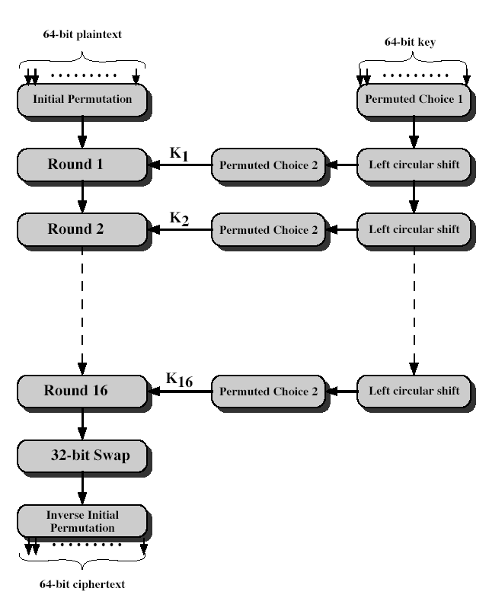
DES Encryption
Dr.M.Nirupama Bhat, Assoc. Professor, Dept of CSE
Notes:
The basic process in enciphering a 64-bit data block using the DES, shown on the left side, consists of:
- an initial permutation (IP)
- 16 rounds of a complex key dependent round function involving substitution and permutation functions
- a final permutation, being the inverse of IP
The right side shows the handling of the 56-bit key and consists of:
- an initial permutation of the key (PC1) which selects 56-bits in two 28-bit halves
- 16 stages to generate the subkeys using a left circular shift and a permutation

Slide 23
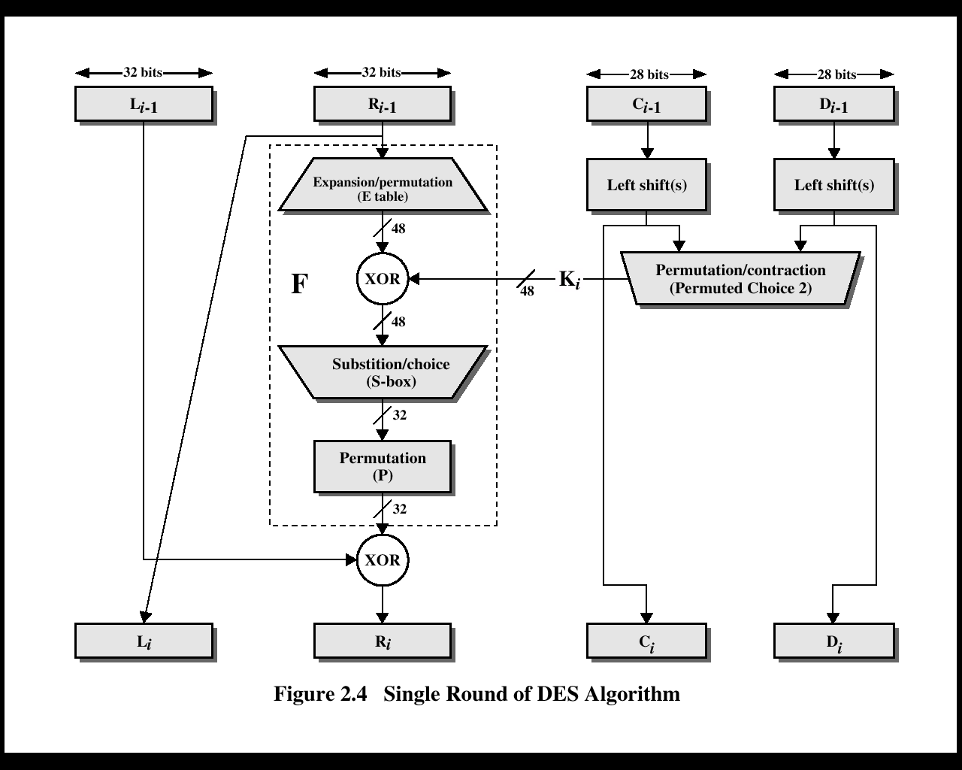
Dr.M.Nirupama Bhat, Assoc. Professor, Dept of CSE

Slide 24
Initial Permutation IP
First step of the data computation
IP reorders the input data bits
Even bits to LH half, odd bits to RH half
Quite regular in structure (easy in h/w)
Example:
IP(675a6967 5e5a6b5a) = (ffb2194d 004df6fb)
Dr.M.Nirupama Bhat, Assoc. Professor, Dept of CSE
Notes:
The initial permutation and its inverse are defined by tables, as shown in Tables 3.2a and 3.2b, respectively. The tables are to be interpreted as follows. The input to a table consists of 64 bits numbered from 1 to 64. The 64 entries in the permutation table contain a permutation of the numbers from 1 to 64. Each entry in the permutation table indicates the position of a numbered input bit in the output, which also consists of 64 bits.
Note that the bit numbering for DES reflects IBM mainframe practice, and is the opposite of what we now mostly use - so be careful! Numbers from Bit 1 (leftmost, most significant) to bit 32/48/64 etc (rightmost, least significant).
Note that examples are specified using hexadecimal.

Slide 25
Videos
DES
Dr.M.Nirupama Bhat, Assoc. Professor, Dept of CSE

Slide 26
DES Round Structure
Uses two 32-bit L & R halves
As for any Feistel cipher can describe as:
  L_{i} = R_{i–1}
  R_{i} = L_{i–1} xor F(R_{i–1}, K_{i})
Takes 32-bit R half and 48-bit subkey and:
  expands R to 48-bits using perm E
  adds to subkey
  passes through 8 S-boxes to get 32-bit result
  finally permutes this using 32-bit perm P
Dr.M.Nirupama Bhat, Assoc. Professor, Dept of CSE
Notes:
Note that the s-boxes provide the “confusion” of data and key values, whilst the permutation P then spreads this as widely as possible, so each S-box output affects as many S-box inputs in the next round as possible, giving “diffusion”.

Slide 27
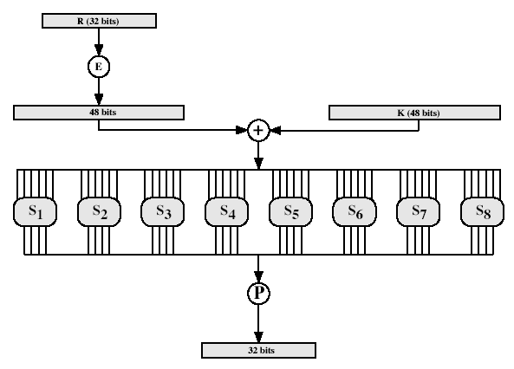
DES Round Structure
Dr.M.Nirupama Bhat, Assoc. Professor, Dept of CSE
Notes:
Stallings Fig 3.9

Slide 28
Substitution Boxes S
Have eight S-boxes which map 6 to 4 bits
Each S-box is actually 4 little 4 bit boxes
  outer bits 1 & 6 (row bits) select one rows
  inner bits 2-5 (col bits) are substituted
  result is 8 lots of 4 bits, or 32 bits
Row selection depends on both data & key
  feature known as autoclaving (autokeying)
Example:
S(18 09 12 3d 11 17 38 39) = 5fd25e03
Dr.M.Nirupama Bhat, Assoc. Professor, Dept of CSE
Notes:
The substitution consists of a set of eight S-boxes, each of which accepts 6 bits as input and produces 4 bits as output. These transformations are defined in Table 3.3, which is interpreted as follows: The first and last bits of the input to box Si form a 2-bit binary number to select one of four substitutions defined by the four rows in the table for Si. The middle four bits select one of the sixteen columns. The decimal value in the cell selected by the row and column is then converted to its 4-bit representation to produce the output. For example, in S1, for input 011001, the row is 01 (row 1) and the column is 1100 (column 12). The value in row 1, column 12 is 9, so the output is 1001.

Slide 29
DES Key Schedule
Forms subkeys used in each round
Consists of:
  initial permutation of the key (PC1) which selects 56-bits in two 28-bit halves
  16 stages consisting of:
    selecting 24-bits from each half
    permuting them by PC2 for use in function f,
    rotating each half separately either 1 or 2 places depending on the key rotation schedule K
Dr.M.Nirupama Bhat, Assoc. Professor, Dept of CSE
Notes:
The 56 bit key size comes from security considerations as we know now. It was big enough so that an exhaustive key search was about as hard as the best direct attack (a form of differential cryptanalysis called a T-attack, known by the IBM & NSA researchers), but no bigger. The extra 8 bits were then used as parity (error detecting) bits, which makes sense given the original design use for hardware communications links. However we hit an incompatibility with simple s/w implementations since the top bit in each byte is 0 (since ASCII only uses 7 bits), but the DES key schedule throws away the bottom bit! A good implementation needs to be cleverer!
Details of these permutations and the key rotation schedule are given in text Table 3.4.

Slide 30
DES Decryption
Decrypt must unwind steps of data computation
With Feistel design, do encryption steps again
Using subkeys in reverse order (SK16 … SK1)
Note that IP undoes final FP step of encryption
1st round with SK16 undoes 16th encrypt round
….
16th round with SK1 undoes 1st encrypt round
then final FP undoes initial encryption IP
thus recovering original data value
Dr.M.Nirupama Bhat, Assoc. Professor, Dept of CSE

Slide 31
Avalanche Effect
Key desirable property of encryption alg
where a change of one input or key bit results in changing approx half output bits
DES exhibits strong avalanche effect
Dr.M.Nirupama Bhat, Assoc. Professor, Dept of CSE

Slide 32

Dr.M.Nirupama Bhat, Assoc. Professor, Dept of CSE

Slide 33
Strength of DES – Key Size
56-bit keys have 2⁵⁶ = 7.2 x 10¹⁶ values
Brute force search looks hard
Recent advances have shown is possible
  in 1997 on Internet in a few months
  in 1998 on dedicated h/w (EFF) in a few days
  in 1999 above combined in 22hrs!
Still must be able to recognize plaintext
Now considering alternatives to DES
Dr.M.Nirupama Bhat, Assoc. Professor, Dept of CSE
Notes:
DES finally and definitively proved insecure in July 1998, when the Electronic Frontier Foundation (EFF) announced that it had broken a DES encryption using a special-purpose "DES cracker" machine that was built for less than $250,000. The attack took less than three days. The
EFF has published a detailed description of the machine, enabling others to build their own cracker [EFF98].

Slide 34
Strength of DES – Timing Attacks
Attacks actual implementation of cipher
Use knowledge of consequences of implementation to derive knowledge of some/all subkey bits
Specifically use fact that calculations can take varying times depending on the value of the inputs to it
Particularly problematic on smartcards
Dr.M.Nirupama Bhat, Assoc. Professor, Dept of CSE
Notes:
AES analysis process has highlighted this attack approach, and is a concern.

Slide 35
Strength of DES – Analytic Attacks
Now have several analytic attacks on DES
These utilise some deep structure of the cipher
  by gathering information about encryptions
  can eventually recover some/all of the sub-key bits
  if necessary then exhaustively search for the rest
Generally these are statistical attacks
Include
  differential cryptanalysis
  linear cryptanalysis
  related key attacks
Dr.M.Nirupama Bhat, Assoc. Professor, Dept of CSE

Slide 36

Dr.M.Nirupama Bhat, Assoc. Professor, Dept of CSE

Slide 37
Modes of Operation
Block ciphers encrypt fixed size blocks
Eg. DES encrypts 64-bit blocks, with 56-bit key
Need way to use in practise, given usually have arbitrary amount of information to encrypt
Four were defined for DES in ANSI standard ANSI X3.106-1983 Modes of Use
Subsequently now have 5 for DES and AES
Have block and stream modes
Dr.M.Nirupama Bhat, Assoc. Professor, Dept of CSE
Notes:
DES (or any block cipher) forms a basic building block, which en/decrypts a fixed sized block of data. However to use these in practise, we usually need to handle arbitrary amounts of data, which may be available in advance (in which case a block mode is appropriate), and may only be available a bit/byte at a time (in which case a stream mode is used).

Slide 38
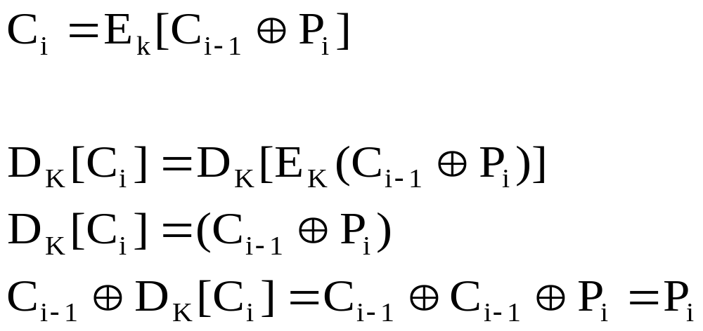
Cipher Block Modes of Operation
Cipher Block Chaining Mode (CBC)
  The input to the encryption algorithm is the XOR of the current plaintext block and the preceding ciphertext block.
  Repeating pattern of 64-bits are not exposed
Dr.M.Nirupama Bhat, Assoc. Professor, Dept of CSE

Slide 39
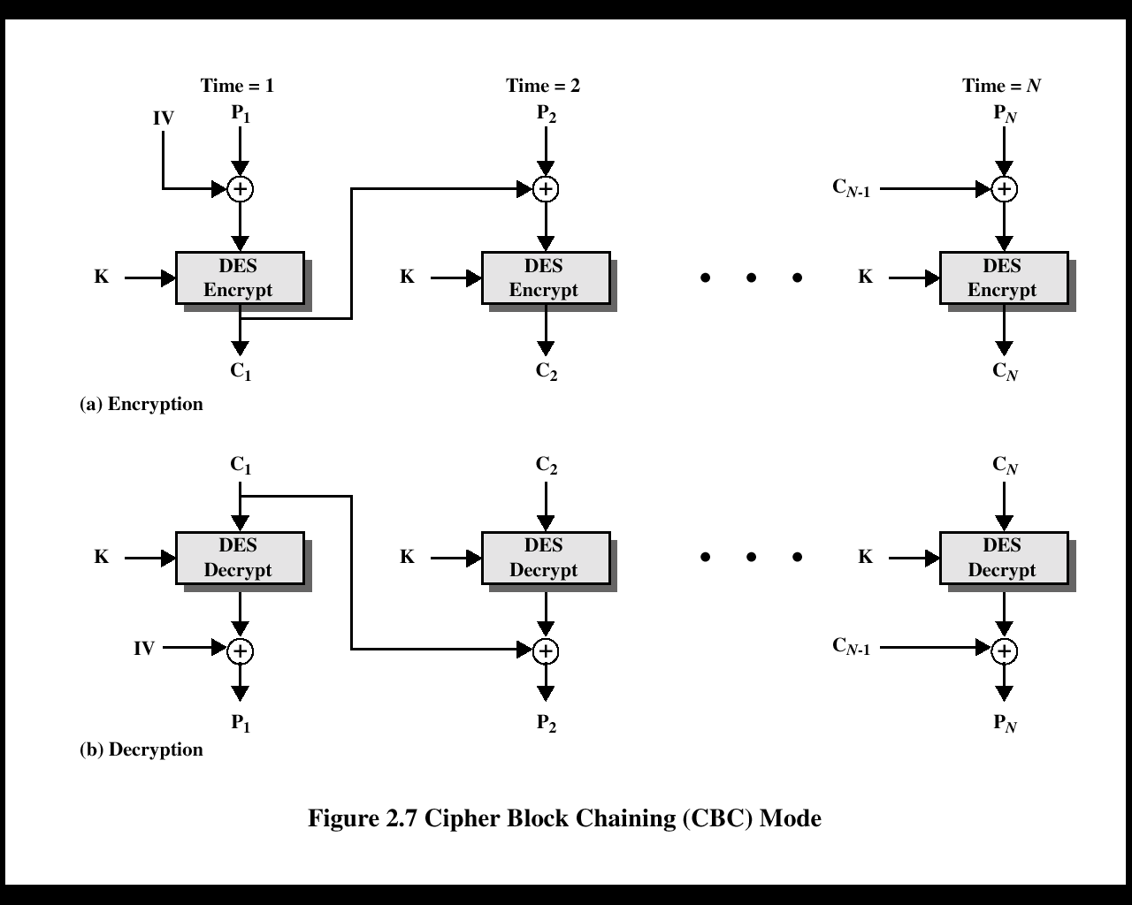
Dr.M.Nirupama Bhat, Assoc. Professor, Dept of CSE

Slide 40

Dr.M.Nirupama Bhat, Assoc. Professor, Dept of CSE

Slide 41
Triple DEA
Use three keys and three executions of the DES algorithm (encrypt-decrypt-encrypt)
    C = ciphertext
    P = Plaintext
    EK[X] = encryption of X using key K
    DK[Y] = decryption of Y using key K
Effective key length of 168 bits
C = EK3[DK2[EK1[P]]]
Dr.M.Nirupama Bhat, Assoc. Professor, Dept of CSE

Slide 42
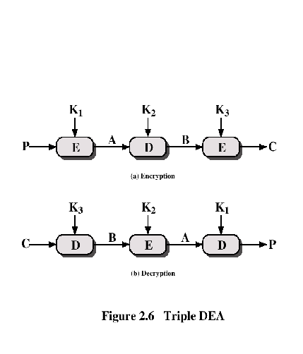
Triple DEA
Dr.M.Nirupama Bhat, Assoc. Professor, Dept of CSE

Slide 43
Other Symmetric Block Ciphers
International Data Encryption Algorithm (IDEA)
  128-bit key
  Used in PGP
Blowfish
  Easy to implement
  High execution speed
  Run in less than 5K of memory
Dr.M.Nirupama Bhat, Assoc. Professor, Dept of CSE

Slide 44
Other Symmetric Block Ciphers
RC5
  Suitable for hardware and software
  Fast, simple
  Adaptable to processors of different word lengths
  Variable number of rounds
  Variable-length key
  Low memory requirement
  High security
  Data-dependent rotations
Cast-128
  Key size from 40 to 128 bits
  The round function differs from round to round
Dr.M.Nirupama Bhat, Assoc. Professor, Dept of CSE

Slide 45
Stream Ciphers
Process the message bit by bit (as a stream)
Typically have a (pseudo) random stream key
Combined (XOR) with plaintext bit by bit
Randomness of stream key completely destroys any statistically properties in the message
  C_{i} = M_{i} XOR StreamKey_{i}
What could be simpler!!!!
But must never reuse stream key
  otherwise can remove effect and recover messages
Dr.M.Nirupama Bhat, Assoc. Professor, Dept of CSE

Slide 46
Stream Cipher Properties
Some design considerations are:
  long period with no repetitions
  statistically random
  depends on large enough key
  large linear complexity
  correlation immunity
  confusion
  diffusion
  use of highly non-linear boolean functions
Dr.M.Nirupama Bhat, Assoc. Professor, Dept of CSE
Notes:
Criteria from Rueppel

Slide 47

Dr.M.Nirupama Bhat, Assoc. Professor, Dept of CSE

Slide 48
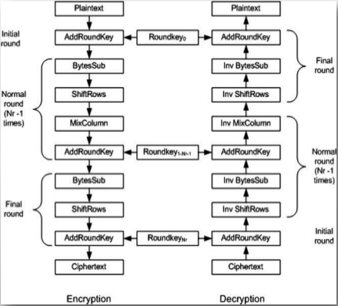
Advanced Encryption Standard
Dr.M.Nirupama Bhat, Assoc. Professor, Dept of CSE

Slide 49
Videos
AES
Dr.M.Nirupama Bhat, Assoc. Professor, Dept of CSE

Slide 50

Dr.M.Nirupama Bhat, Assoc. Professor, Dept of CSE

Slide 51
RC4
A proprietary cipher owned by RSA DSI
Another Ron Rivest design, simple but effective
Variable key size, byte-oriented stream cipher
Widely used (web SSL/TLS, wireless WEP)
Key forms random permutation of all 8-bit values
Uses that permutation to scramble input info processed a byte at a time
Dr.M.Nirupama Bhat, Assoc. Professor, Dept of CSE

Slide 52
RC4 Key Schedule
Starts with an array S of numbers: 0..255
Use key to well and truly shuffle
S forms internal state of the cipher
Given a key k of length l bytes
  for i = 0 to 255 do
    S[i] = i
  j = 0
  for i = 0 to 255 do
    j = (j + S[i] + k[i mod l]) (mod 256)
    swap (S[i], S[j])
Dr.M.Nirupama Bhat, Assoc. Professor, Dept of CSE
Notes:
The RC4 key schedule intializes the state S to the numbers 0..255, and then walks thru each entry in turn, using its current value plus the next byte of key to pick another entry in the array, and swaps their values over. After doing this 256 times, the result is a well and truly shuffled array. The total number of possible states is 256! - a truly enormous number, much larger even than the 2048-bit (256*8) max key allowed can select.

Slide 53
RC4 Encryption
Encryption continues shuffling array values
Sum of shuffled pair selects "stream key" value
tXOR with next byte of message to en/decrypt
  i = j = 0
  for each message byte M_{i}
    i = (i + 1) (mod 256)
    j = (j + S[i]) (mod 256)
    swap(S[i], S[j])
    t = (S[i] + S[j]) (mod 256)
    C_{i} = M_{i} XOR S[t]
Dr.M.Nirupama Bhat, Assoc. Professor, Dept of CSE
Notes:
To form the stream key for en/decryption (which are identical), RC4 continues to shuffle the permutation array S by continuing to swap each element in turn with some other entry, and using the sum of these two entry values to select another value to use as the stream key.

Slide 54
RC4 Security
Claimed secure against known attacks
  have some analyses, none practical
Result is very non-linear
Since RC4 is a stream cipher, must never reuse a key
Have a concern with WEP, but due to key handling rather than RC4 itself
Dr.M.Nirupama Bhat, Assoc. Professor, Dept of CSE
Notes:
RC4 is widely used, in SSL for secure web transactions amongst other uses. Currently its regarded as quite secure, if used correctly.

